Slide 1
Country Clustering using Unsupervised Learning for HELP International

Slide 2
About the data
Clustering the Countries by using Unsupervised Learning for HELP International
Objective:
To categorise the countries using socio-economic and health factors that determine the overall development of the country.
About organization:
HELP International is an international humanitarian NGO that is committed to fighting poverty and providing the people of backward countries with basic amenities and relief during the time of disasters and natural calamities.
Problem Statement:
HELP International have been able to raise around $ 10 million. Now the CEO of the NGO needs to decide how to use this money strategically and effectively. So, CEO has to make decision to choose the countries that are in the direst need of aid. Hence, your Job as a Data scientist is to categorise the countries using some socio-economic and health factors that determine the overall development of the country. Then you need to suggest the countries which the CEO needs to focus on the most.
https://www.kaggle.com/datasets/rohan0301/unsupervised-learning-on-country-data

Slide 3
About analysis
1. Importing libraries
2. EDA
3. Scaling data
4. Principal component analysis (PCA)
5. Clustering data
6. Suggestions

Slide 4
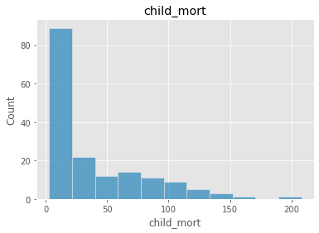
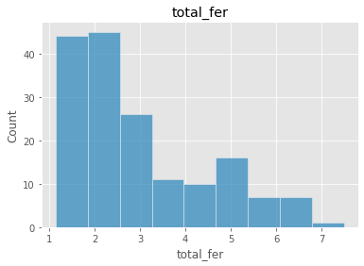
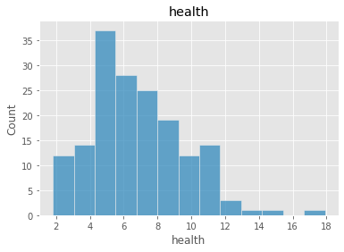
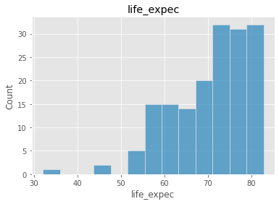
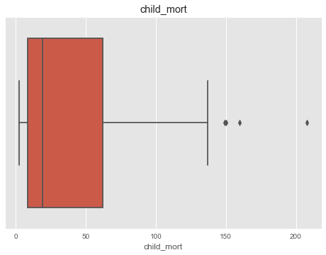
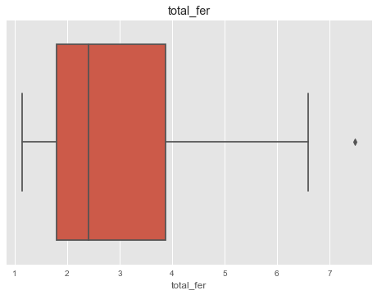
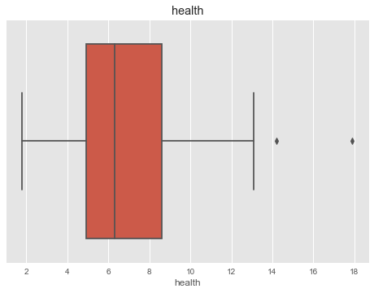
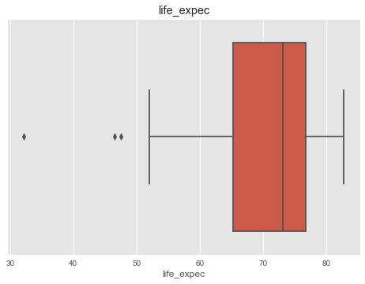
EDA: Health related variables
Children mortality, total fertality, health and lif expectancy are not normal distribution.
There are outliers in each variables.

Slide 5
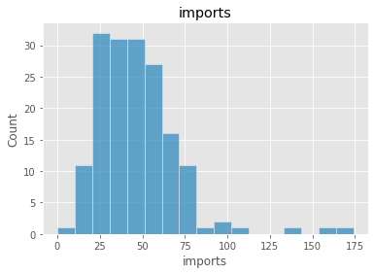
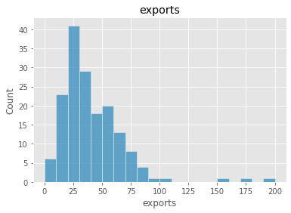
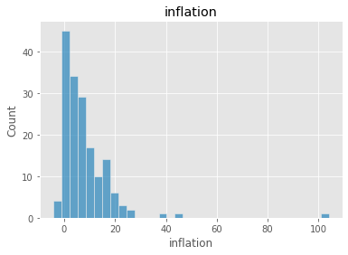
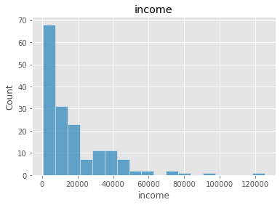
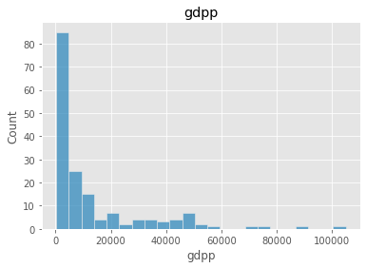
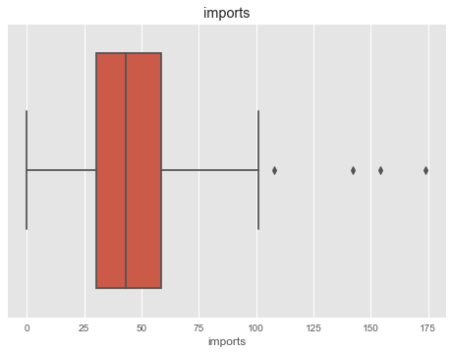
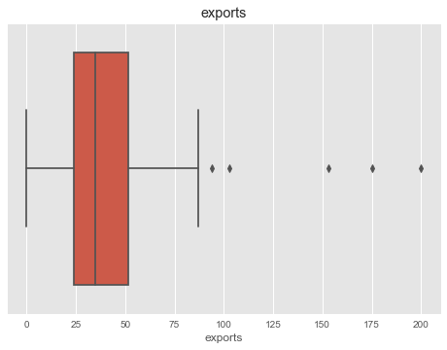
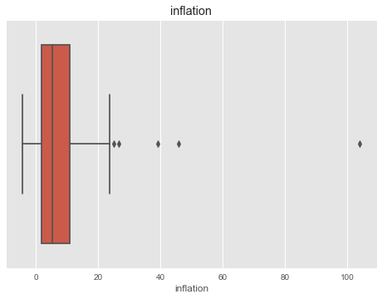
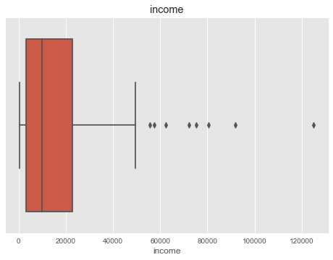
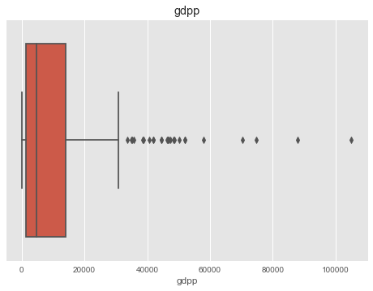
EDA: Economy related variables
Similiar to health related variables: not normal distributed and with outliers

Slide 6
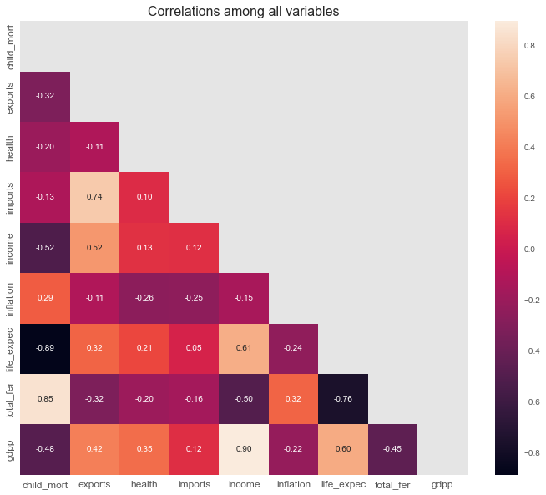
EDA: Correlations of variables
life_expec and child_mort are correlated r = -0.89
total_fer and child_mort are correlated r = 0.85
imports and exports are correlated r = 0.74
gdpp and income are correlated r = 0.9
total_fer and life_expec are correlated r = -0.76

Slide 7
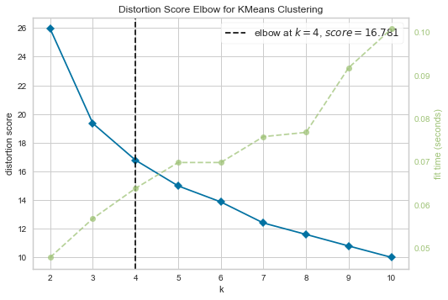
Preprocessing Data
Scaling Data
PCA
Kmeans
Note
Data are:
(1) not normal distributed
(2) outliers in each variable
To scale the data:
MinMaxScaler will be better.
Outliers play an import role in this analysis
The effect of outliers should not be deminished

Slide 8
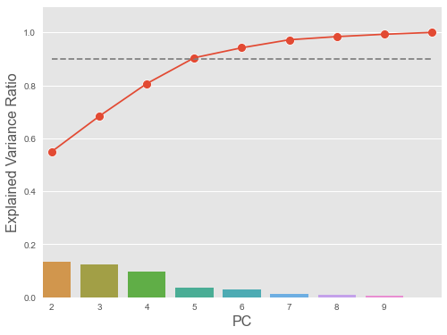
Preprocessing Data
Scaling Data
PCA
Kmeans
Note:
Based ont the analysis four components
can explaine 90% of variance.

Slide 9
Preprocessing Data
Scaling Data
PCA
Kmeans
Note:
Based ont the analysis the data should be clustered into four.

Slide 10
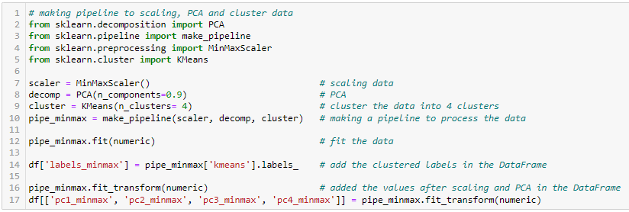
Preprocessing and fit the Data
Scaling Data
PCA
Kmeans

Slide 11
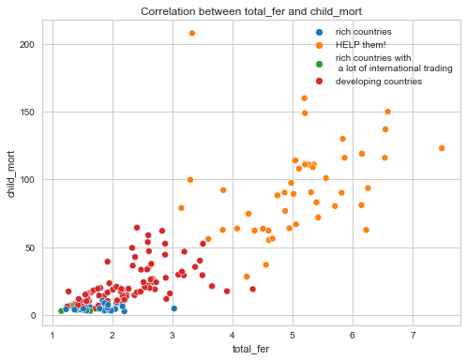
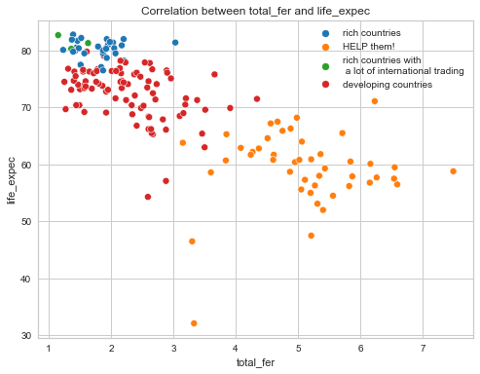
Visualizing the clusters

Slide 12
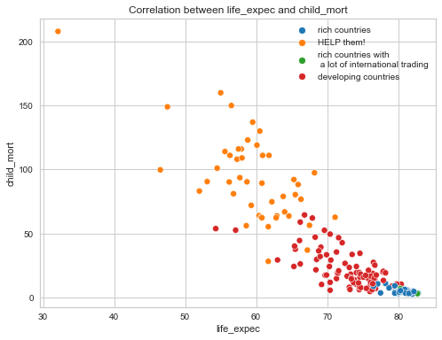
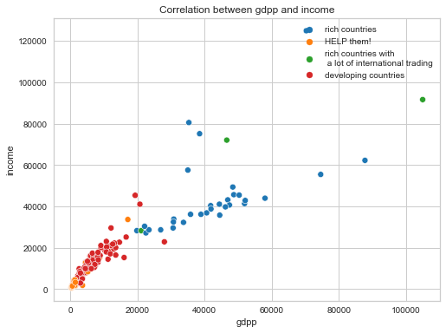
Visualizing the clusters

Slide 13
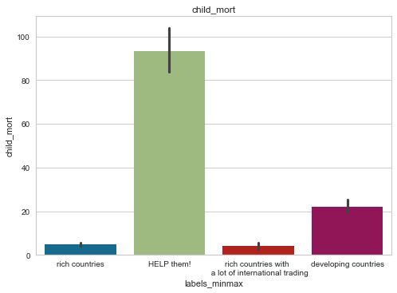
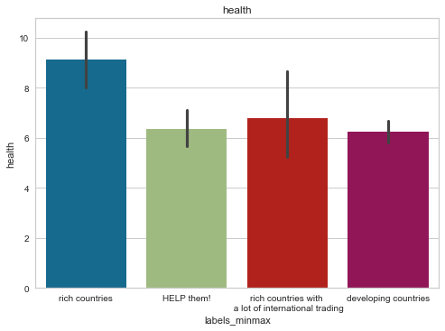
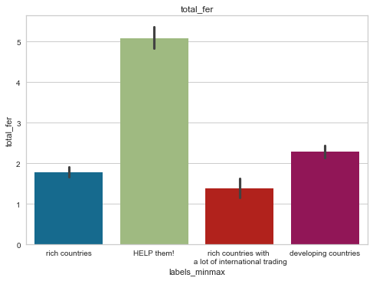
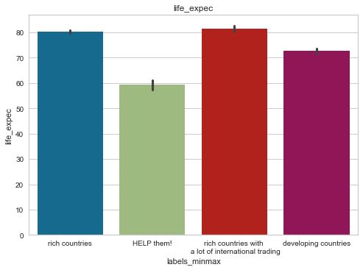
Visualizing the feature of the countries needing help: Health related variables
High children mortality
Low health
High total fertality
Low life expectancy

Slide 14
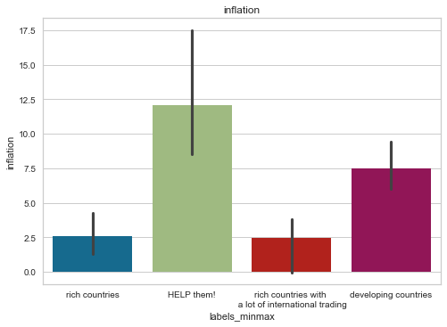
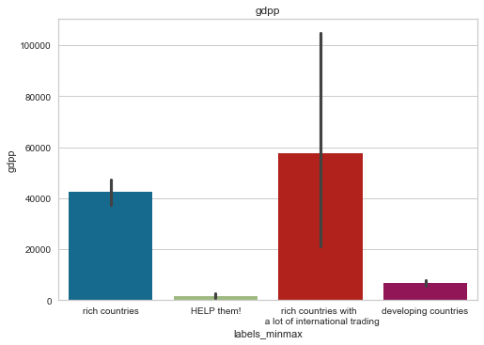
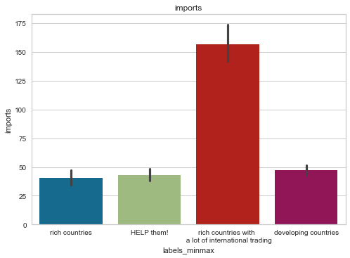
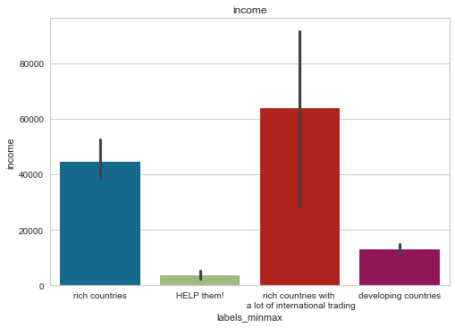
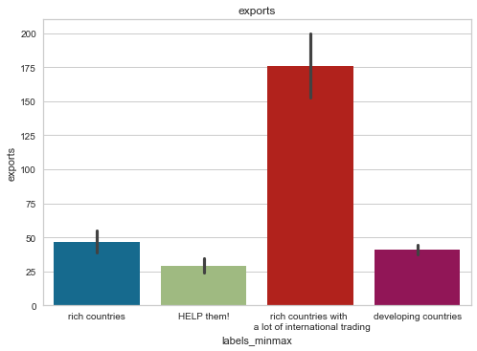
Visualizing the feature of the countries needing help: Economy related variables
High inflation
Low GDP
Low income
Low import
Low export

Slide 15
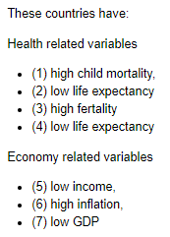
Results
Based on the analysis results 46 countries needs help

